Slide 1
Resource: Water

Slide 2
Water Distribution
Canada has 0.5% of Earth’s population
…but 20% of it’s fresh water
World’s Water
World’s Fresh Water

Slide 3
Thermal power generation: Coal, nuclear, natural gas power plants

Slide 4
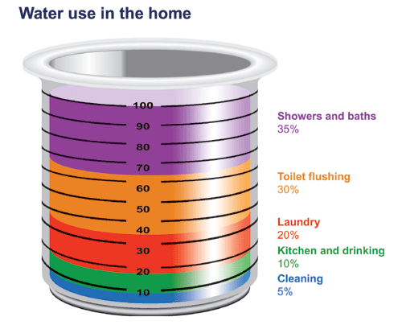

Slide 5
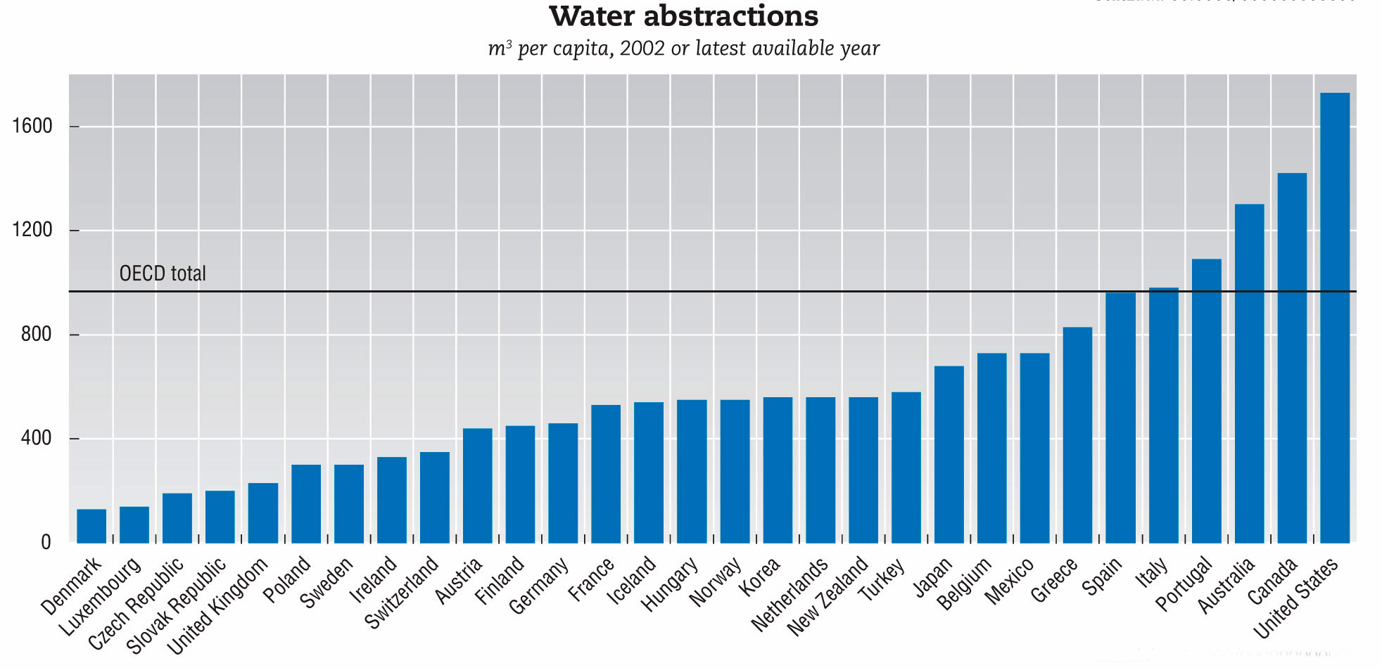
Canada’s Water Consumption
How does Canada compare to other developed countries?

Slide 6
Water problems
As the world’s population increases the amount of clean fresh water is decreasing

Slide 7
International Water Issues
one in eight people (884 million) lack access to safe water supplies
3.6 million people die each year from water-related disease.
Poor people living in the slums often pay 5-10 times more per liter of water than wealthy people living in the same city.

Slide 8
Local Water Issues: Great Lakes
Great lakes water levels dropping due to climate change
Pressure to send water from Great Lakes to southern USA
Pollution from industries surrounding lakes

Slide 9
