Slide 1
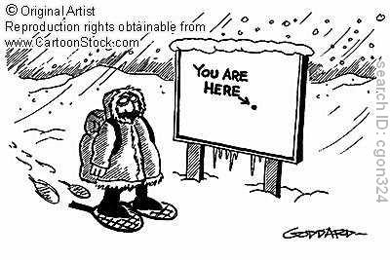
Maps: The Geographer’s Basic Tools

Slide 2
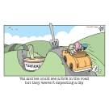
What is a Map?
It is a representation of Earth’s features drawn on a flat surface.

Slide 3
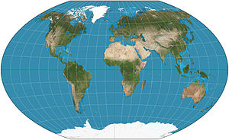
Map Projections
Winkel tripel projection: Winkel's goal of minimizing three kinds of distortion area, direction and distance.

Slide 4
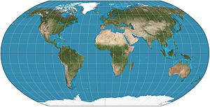
Map Projections
Robinson projection: The Robinson projection is a map projections of a world map, which shows the entire world at once. It was specifically created in an attempt to find a good compromise to the problem of readily showing the whole globe as a flat image.[

Slide 5
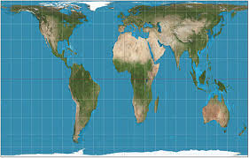
Map Projections
Petersen Projection

Slide 6
Map Projections West Wing
http://www.youtube.com/watch?v=n8zBC2dvERM

Slide 7
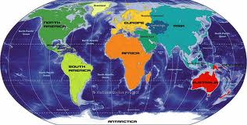
Scale
The scale of the map shows the relationship between the size of an object (eg lake, highway,) in real life and its size drawn on the map.
Small-scale maps show a small amount of detail in a large area. Eg world map
1: 17 500 000

Slide 8
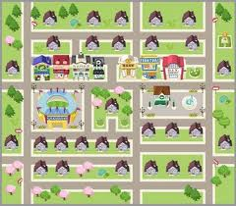
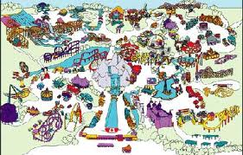
Scale cont’d
Large scale maps show a large amount of detail in a small area. Eg residential planning, Canada’s Wonderland,...
1: 500, 1: 25 000

Slide 9
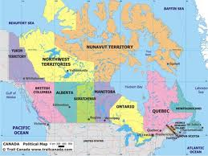
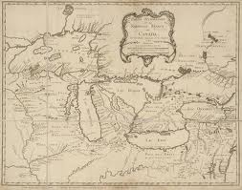
Types of Maps
General-purpose maps: provide many types of information on one map.
Examples: bodies of water, roads, railway lines, parks, elevation, towns and cities, political boundaries, latitude and longitude, national and provincial parks

Slide 10
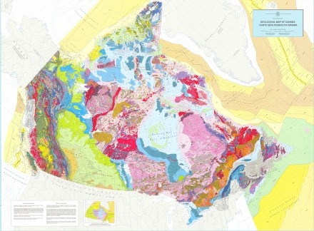
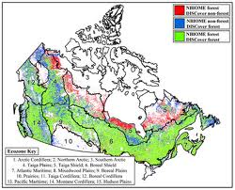
Types of maps con’td
Thematic Maps illustrate specific information about a place.
Examples: climate regions, religions, age cohorts, ...

Slide 11
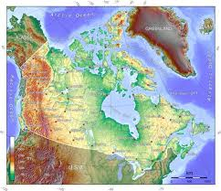
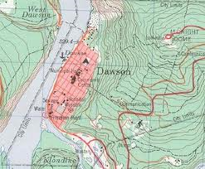
Types of maps con’td
Topographic Maps use symbols to show a variety of features. Two important features are contour lines and a grid system. See text pg. 25

Slide 12
Activity: Digital Mapping (page 26)
Complete the activity # 1 – 5
(Google maps)

